Slide 1
Micro Credit Defaulter
Aarti Ambhore

Slide 2
Problem Statement:
A Microfinance Institution (MFI) is an organization that offers financial services to low income populations. MFS becomes very useful when targeting especially the unbanked poor families living in remote areas with not much sources of income. The Microfinance services (MFS) provided by MFI are Group Loans, Agricultural Loans, Individual Business Loans and so on.
Many microfinance institutions (MFI), experts and donors are supporting the idea of using mobile financial services (MFS) which they feel are more convenient and efficient, and cost saving, than the traditional high-touch model used since long for the purpose of delivering microfinance services. Though, the MFI industry is primarily focusing on low income families and are very useful in such areas, the implementation of MFS has been uneven with both significant challenges and successes.
Today, microfinance is widely accepted as a poverty-reduction tool, representing $70 billion in outstanding loans and a global outreach of 200 million clients.

Slide 3
We are working with one such client that is in Telecom Industry. They are a fixed wireless telecommunications network provider. They have launched various products and have developed its business and organization based on the budget operator model, offering better products at Lower Prices to all value conscious customers through a strategy of disruptive innovation that focuses on the subscriber.
They understand the importance of communication and how it affects a person’s life, thus, focusing on providing their services and products to low income families and poor customers that can help them in the need of hour.
They are collaborating with an MFI to provide micro-credit on mobile balances to be paid back in 5 days. The Consumer is believed to be defaulter if he deviates from the path of paying back the loaned amount within the time duration of 5 days. For the loan amount of 5 (in Indonesian Rupiah), payback amount should be 6 (in Indonesian Rupiah), while, for the loan amount of 10 (in Indonesian Rupiah), the payback amount should be 12 (in Indonesian Rupiah).
The sample data is provided to us from our client database. It is hereby given to you for this exercise. In order to improve the selection of customers for the credit, the client wants some predictions that could help them in further investment and improvement in selection of customers

Slide 4
Build a model which can be used to predict in terms of a probability for each loan transaction, whether the customer will be paying back the loaned amount within 5 days of insurance of loan. In this case, Label ‘1’ indicates that the loan has been payed i.e. Non- defaulter, while, Label ‘0’ indicates that the loan has not been payed i.e. defaulter.
Points to Remember:
There are no null values in the dataset.
There may be some customers with no loan history.
The dataset is imbalanced. Label ‘1’ has approximately 87.5% records, while, label ‘0’ has approximately 12.5% records.
For some features, there may be values which might not be realistic. You may have to observe them and treat them with a suitable explanation.
You might come across outliers in some features which you need to handle as per your understanding. Keep in mind that data is expensive and we cannot lose more than 7-8% of the data.
Find Enclosed the Data Description File and The Sample Data for the Modeling Exercise.

Slide 5
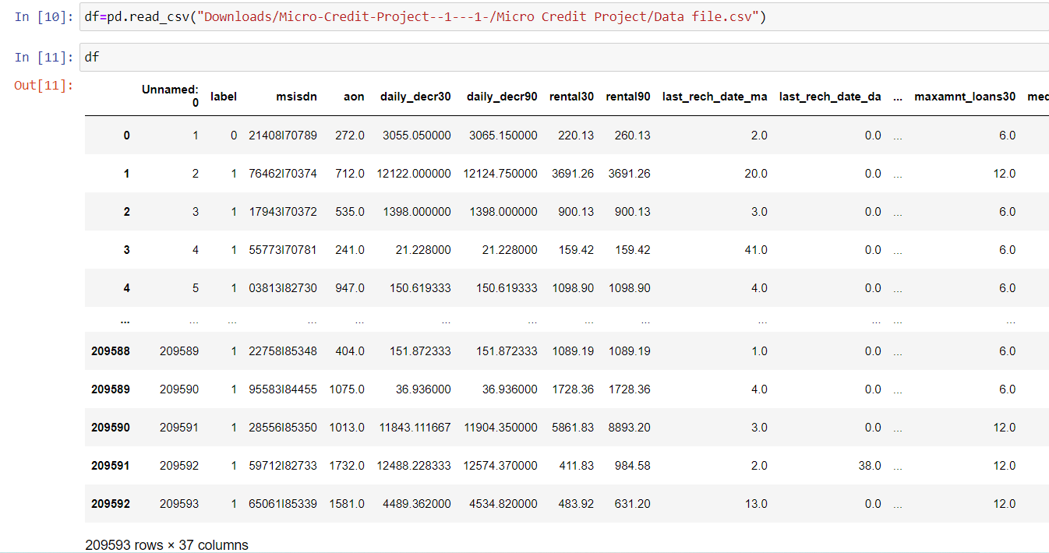
Given data set is read as df:
Dataset having 209593 rows and 37 columns

Slide 6
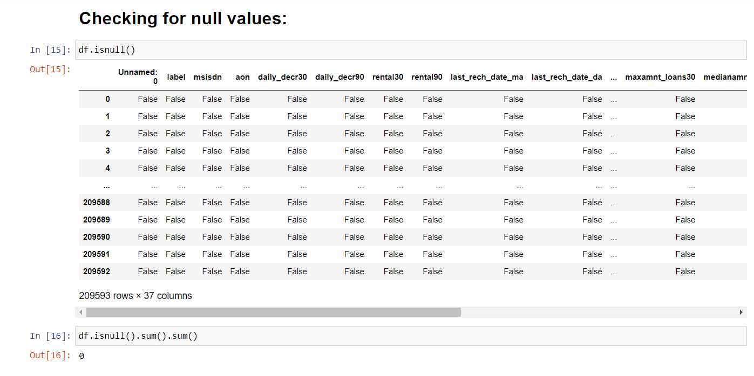
The given dataset do not have any null value.

Slide 7
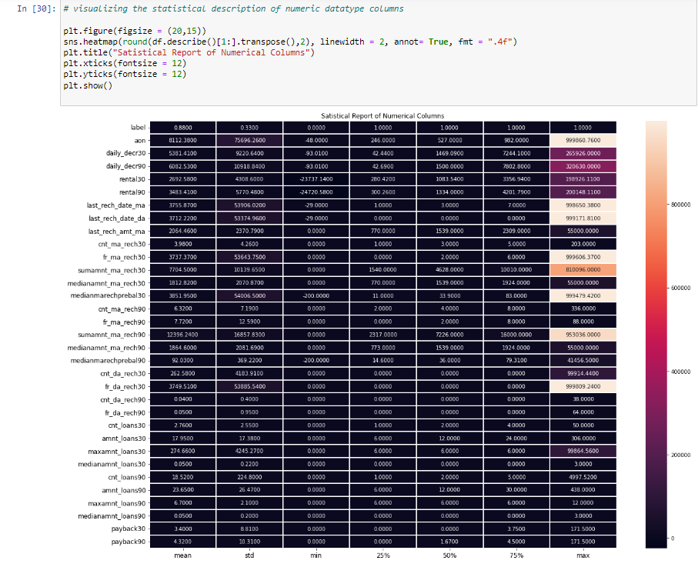
Data Visualisation:
Here we see statistical representation of all numeric columns.

Slide 8
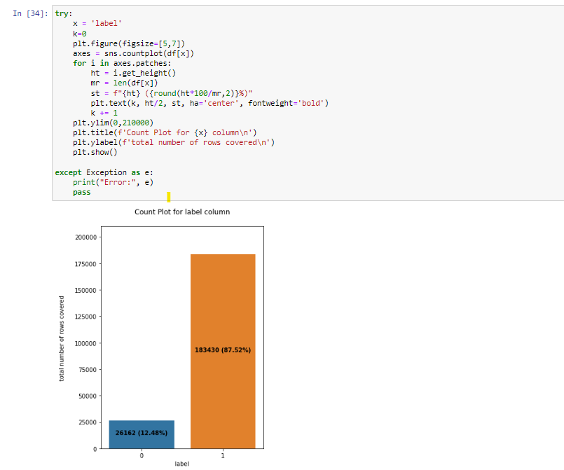
Univariate analysis:

Slide 9
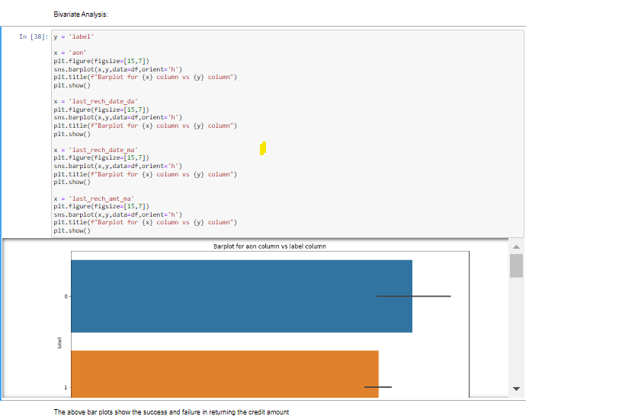
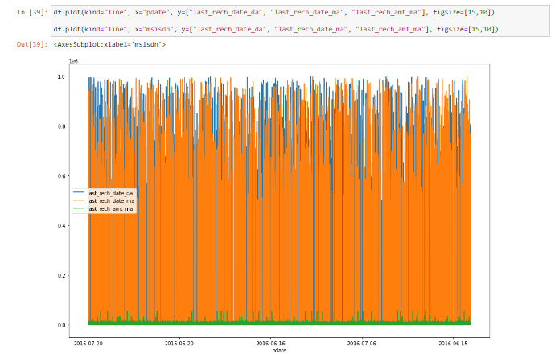
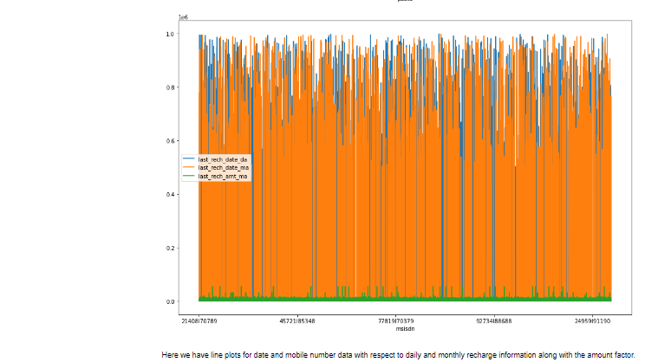
Bivariate Analysis:
With the help of Bar Plot we are able to see the success and failure label data for the columns basically the feature data.

Slide 10
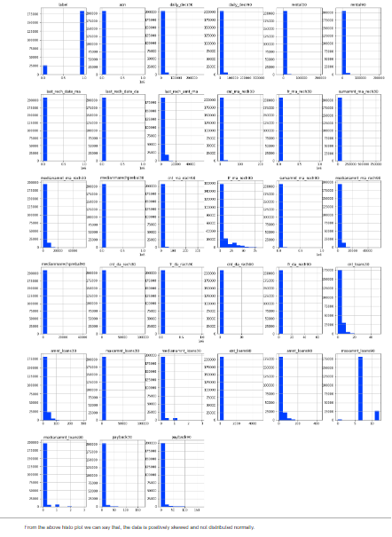
Multivariate Analysis:
I used the histogram to check through all the column details ensuring that the distribution is displayed for further analysis.

Slide 11
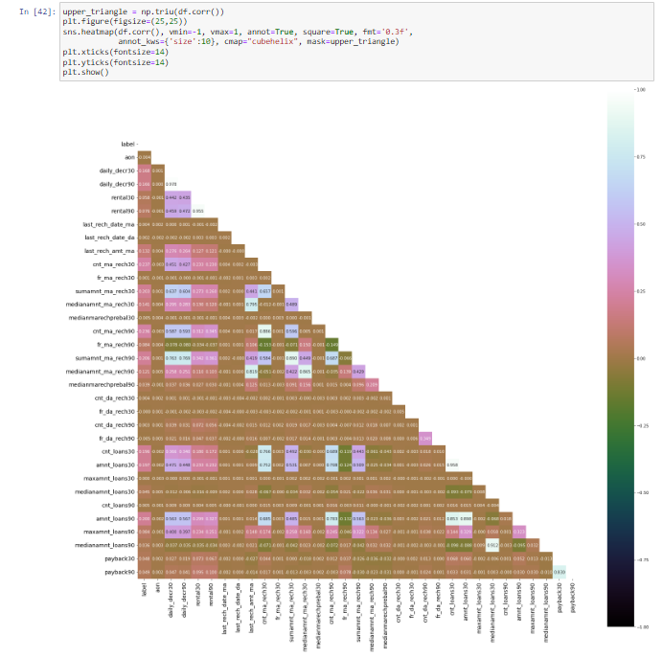
Used the heatmap to check the correlation specifically between the label and feature data columns
Also we checked for any multi collinearity concerns between feature column data.

Slide 12
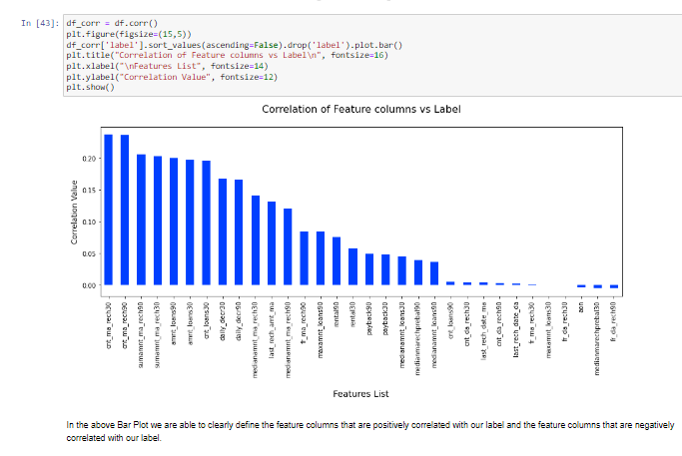
Using a Bar Plot we checked the correlation between the label column and feature columns to determine the one’s that are positively and negatively correlated

Slide 13
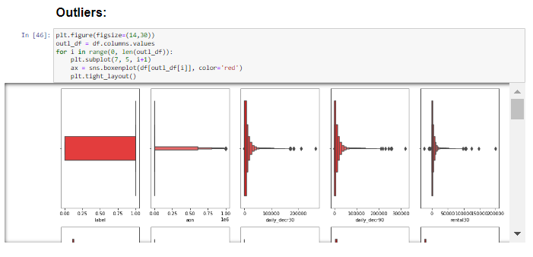
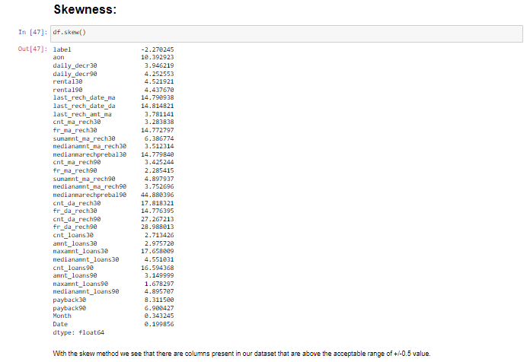
With the skew method we see that there are columns present in our dataset that are above the acceptable range.

Slide 14
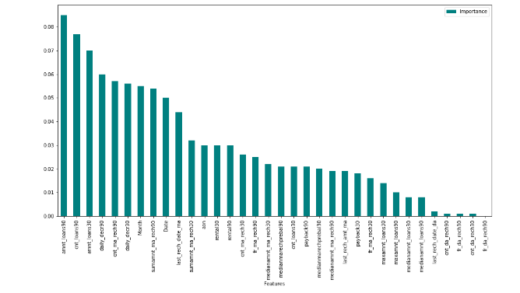
Feature importance of bar graph:
Using the Random Forest Classifier we were able to get the importance data and dropped the least contributing feature columns

Slide 15
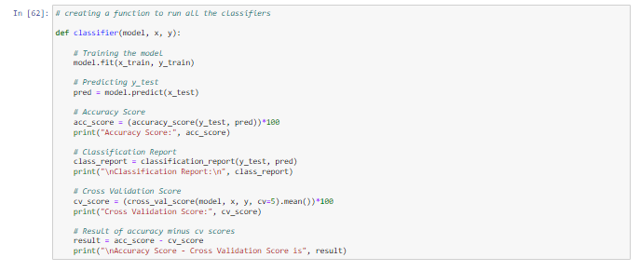
Machine Learning Model:
Logistic Regression
Naïve Bayes
Decision Tree Classifier
KNeighbors Classifier
SGD Classifier
Random Forest Classifier
Extra Trees Classifier
AdaBoost Classifier
Gradient Boost Classifier
Extreme Gradient Boost Classifier

Slide 16
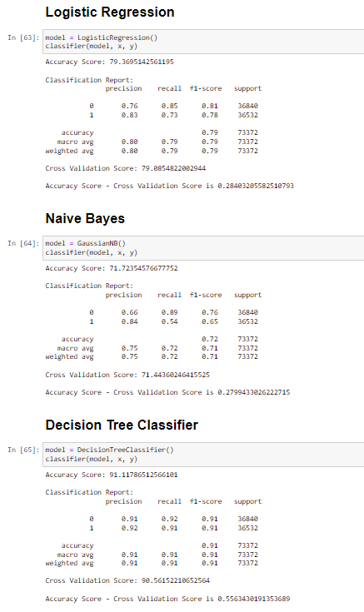
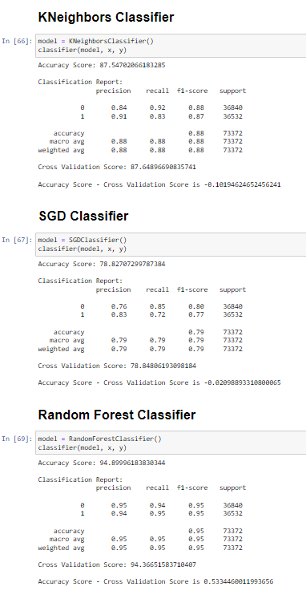
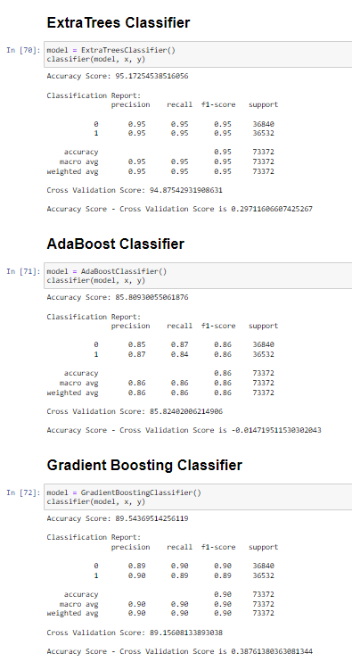

Slide 17
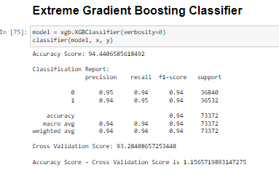
With this Machine learning models we can say that which is the best fit model with high accuracy.

Slide 18
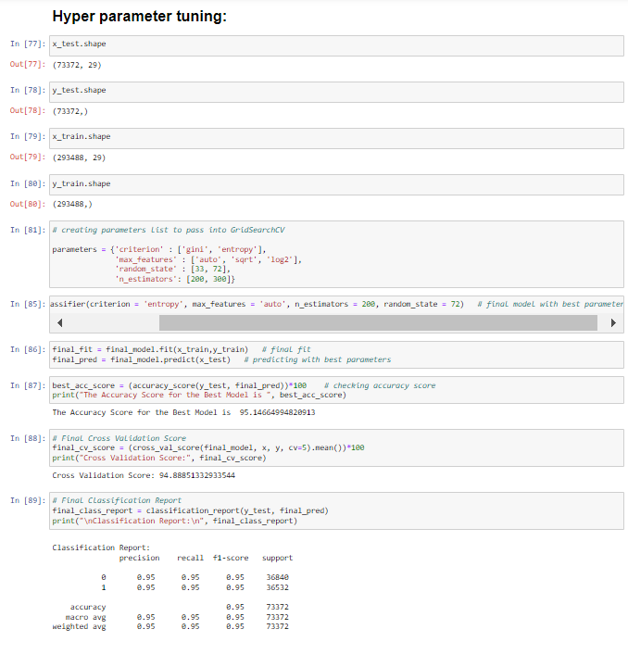
Extra Tree Classifier is the best fit model and perform the hyper parameter tuning on the same model.

Slide 19
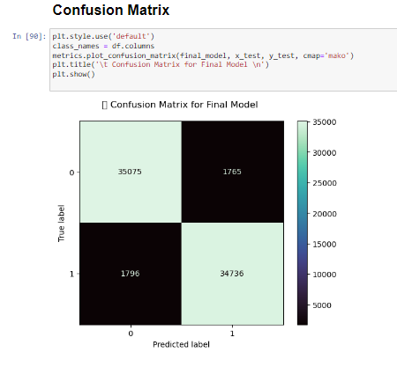
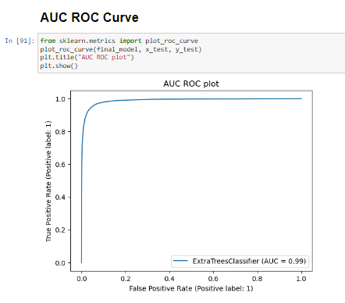
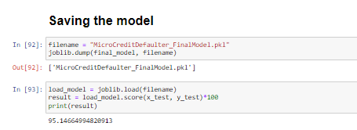
Hyper Parameter tuning result:
Saving the best fit model:

Slide 20
Conclusion:
Key Findings and Conclusions of the Study: From the final model MFI can find if a person will return money or not and should a MFI provide a load to that person or not judging from the various features taken into consideration.
Learning Outcomes of the Study in respect of Data Science: I built multiple classification models and did not rely on one single model for getting better accuracy and using cross validation comparison I ensured that the model does not fall into overfitting and underfitting issues. I picked the best one and performed hyper parameter tuning on it to enhance the scores.
Limitations and Future Scope:
Limitation is it will only work for this particular use case and will need to be modified if tried to be utilized on a different scenario but on a similar scale.
Scope is that we can use it in companies to find whether we should provide loan to a person or not and we can also make prediction about a person buying an expensive service on the basis of there personal details that we have in this dataset like number of times data account got recharged in last 30 days and daily amount spent from main account, averaged over last 30 days (in Indonesian Rupiah) so even a marketing company can also use this.

Slide 21
THANK YOU…!!!

